Slide 1

White House Salary Analysis using SQL in MySQL Workbench SMU- MSDS7330 – Final Project – Presentation Matthew Przybyla & Laura Bishop

Slide 2
1. INTRODUCTION
What’s in our dataset?
* This data is 469 rows and provides the following data elements: Employee Name, Employee Status, Salary , Pay Base, & Position Title
Benefits of our dataset
* It may be downloaded into .csv format, which can be converted to .txt for loading into SQL. The data is clean and is sufficient in size to be meaningful from a database set up and statistical perspectives.
What is our dataset?
* This data set is the foundation of a report provided to Congress detailing salaries of the employees working in the Obama administration’s White House in 2010, used IBM Bluemix + MySQL Workbench for analysis
Why this dataset?
* We chose this dataset because we were inspired by the analysis performed previously in this class on baseball salaries. We want to analyze this dataset’s attributes

Slide 3
1. INTRODUCTION B
What will we examine?
Legislative Assistant Deputy Assistant Assistant Director Deputy Director Deputy Associate Policy Assistant
PositionTitles
Director Analyst Chief of Staff Assistant to the President Deputy Assistant to the President

Slide 4
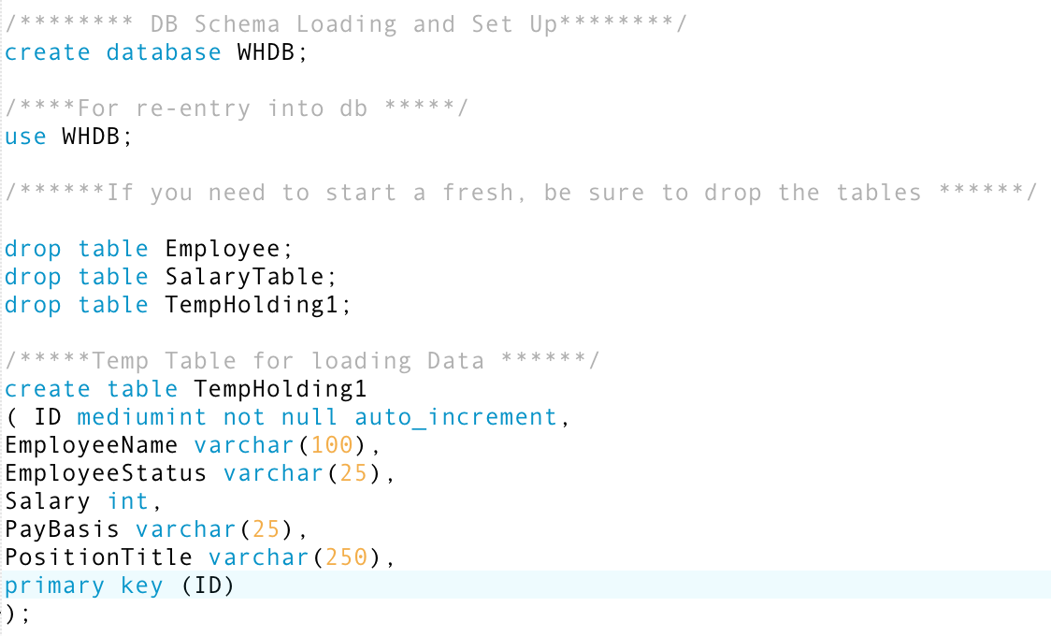
2. Using MySQL to start
Create, use,
1. DB Schema Loading and Set Up 2. For re-entry into database
and drop functions
3. If you need to start a fresh, be sure to drop the tables 4. Temp Table for loading data

Slide 5
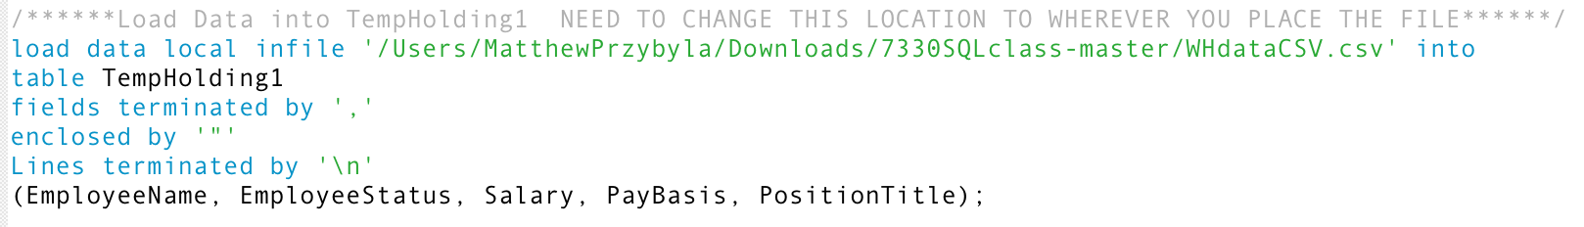
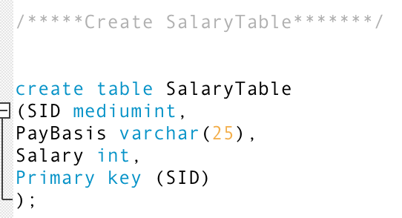
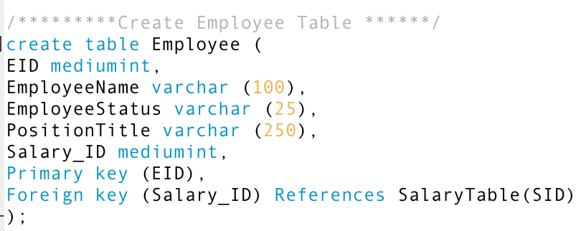
3. Loading and creating table with csv file
Load csv file data and create tables
These images describe the loading of the actual csv file data into a table
Outline key characteristics
Varchar describes the amount of characters allowed, along with the primary and foreign key designations

Slide 6
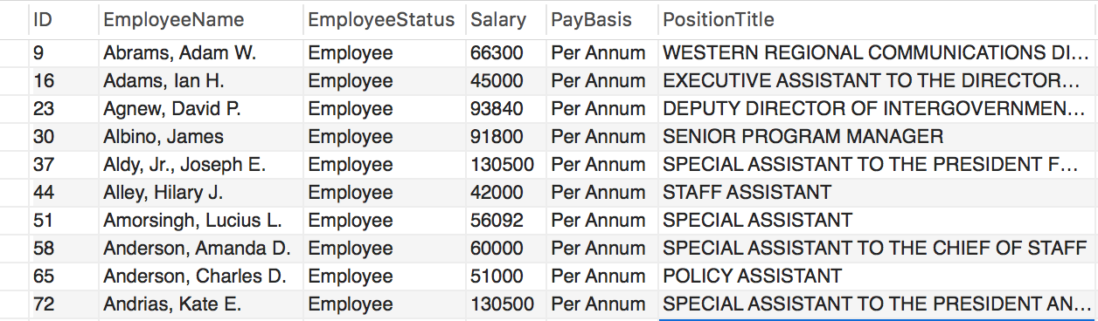
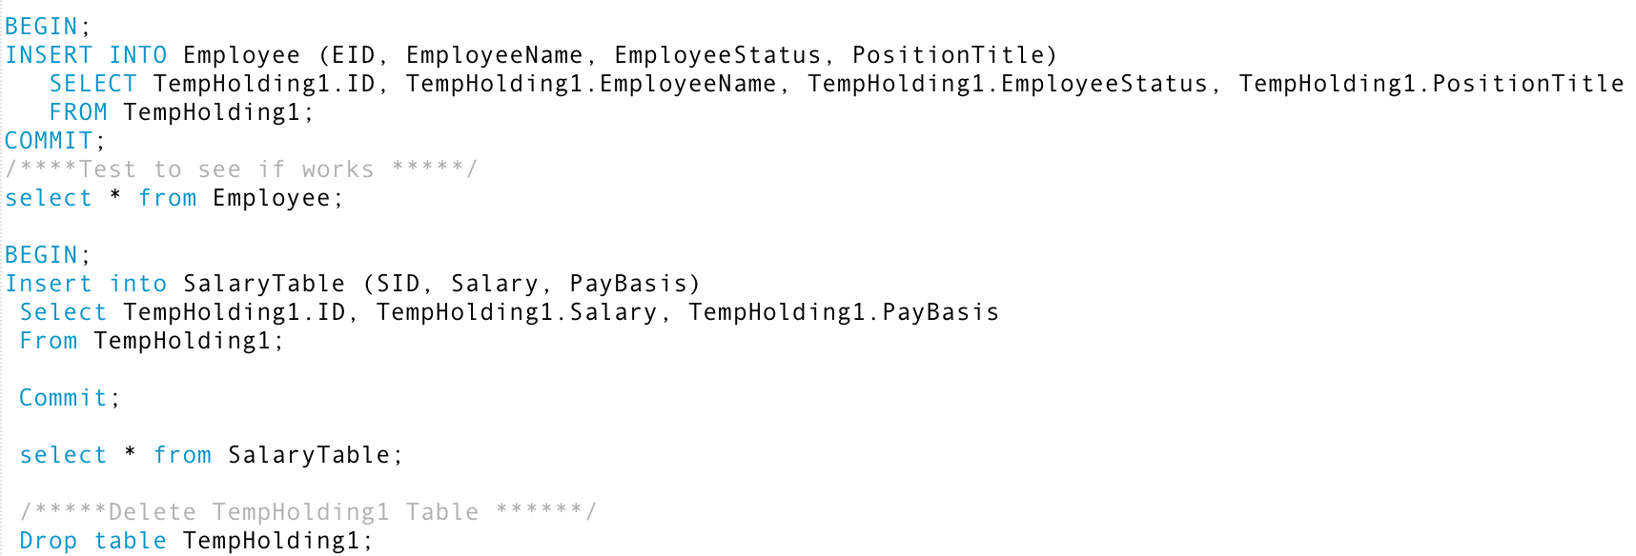
4. Demonstration of breaking tables into normal form
Employee & Salary tables
Assigning EmployeeTable to include EID, Name, Status, and PositionTitle only, assigning SalaryTable to include only SID, Salary, and PayBasis
Double checking by selecting
Selecting each new table to confirm that they contain their respective data

Slide 7
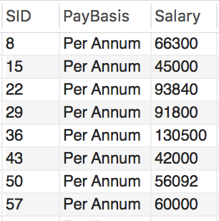
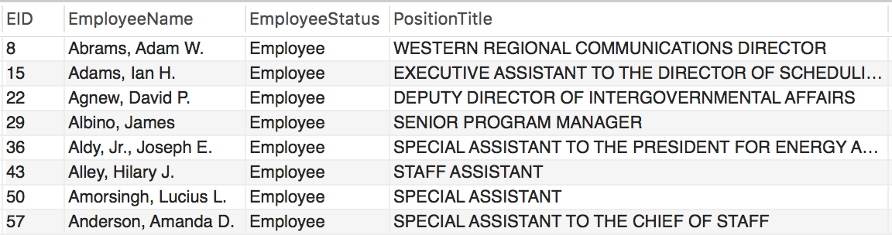
5. A closer look into Employee and Salary tables
Salary Table
Employee & Salary tables
Assigning EmployeeTable to include EID, Name, Status, and PositionTitle only, assigning SalaryTable to include only SID, Salary, and PayBasis
Double checking by selecting
Selecting each new table to confirm that they contain their respective data
Employee Table

Slide 8
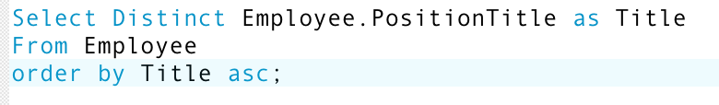
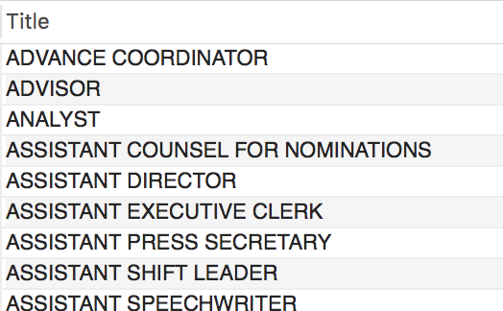
6. Understanding positions titles
Code
Output
Looking at PositionTitles
Selecting distinct means we are looking at the Employee table only and it’s respective PositionTitle and renaming it as ”Title” for simplicity
Order by asc
Using this function in this instance means we are ordering alphabetically

Slide 9
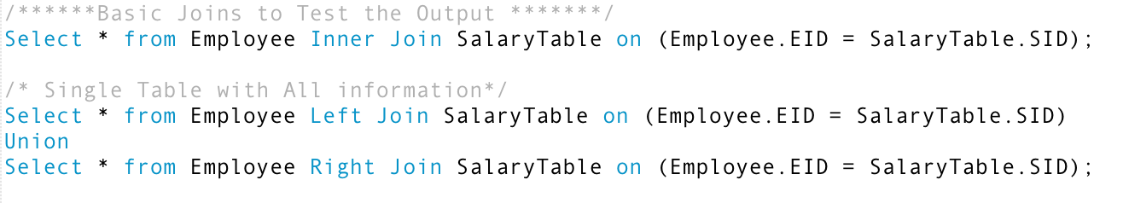
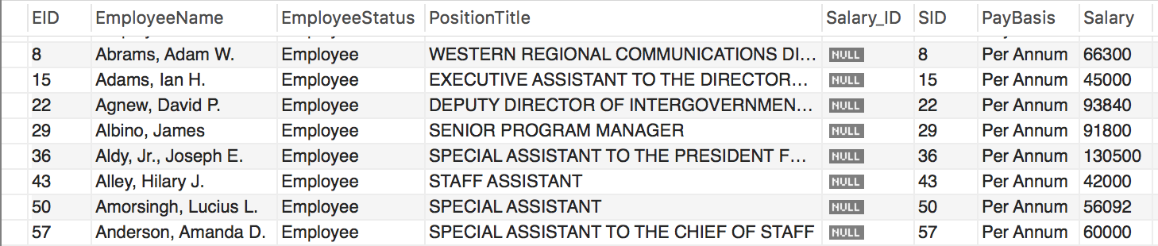
7. Demonstrating joins of our tables
Code
Basic – inner join
Selecting from Employee onto Salary as an inner join to test to see if join in general works
Left – right – all join
Selecting from a table that includes both the Employee and Salary table data via left and right joins
Output

Slide 10
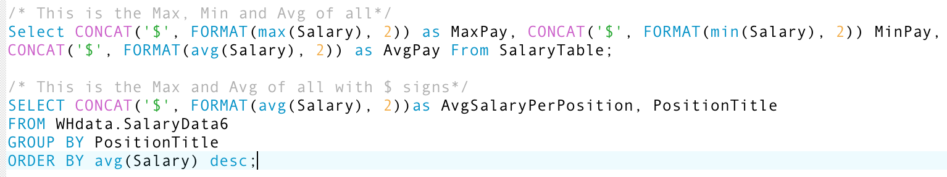
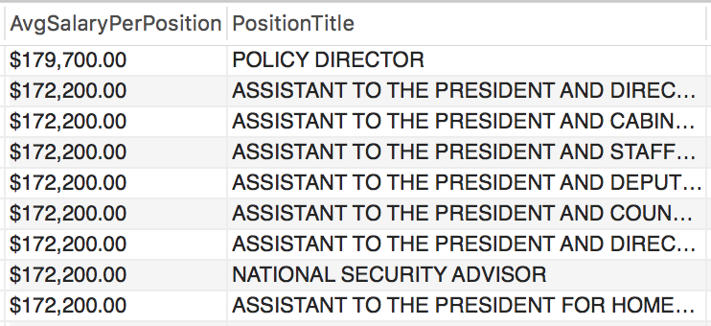
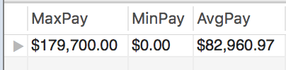
8. First analysis of salaries
Code
Basic summary statistics
Selecting the minimum, maximum, and average salaries; we see that some employees made $0 annually
Formatting
Not necessary, but good to know if the formatting function that will attach the “$” sign onto the salary
Output

Slide 11
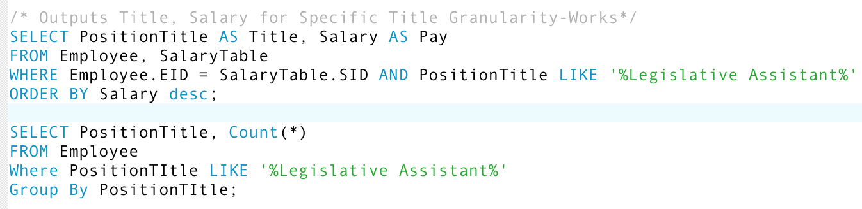
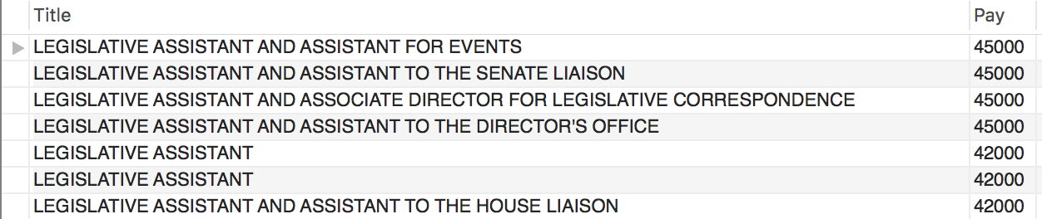
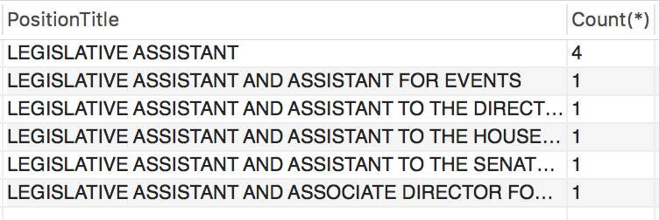
9. A deeper look into Legislative Assistant position title
Code
Using like function
Finding specifically a position title that contains the words “Legislative Assistant”, we notice they were paid the least amount on average
Count function
We used “count” to find that base L.A. title was most common with various similar but unique titles
Output

Slide 12
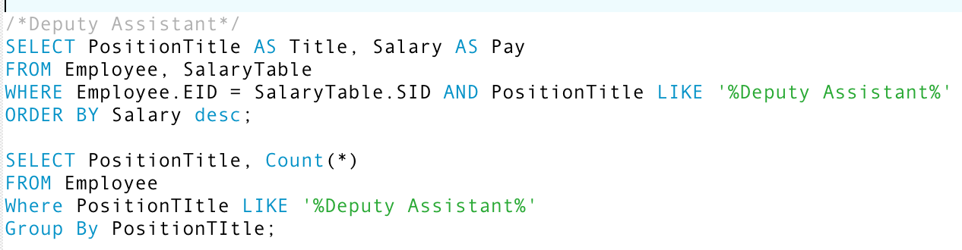
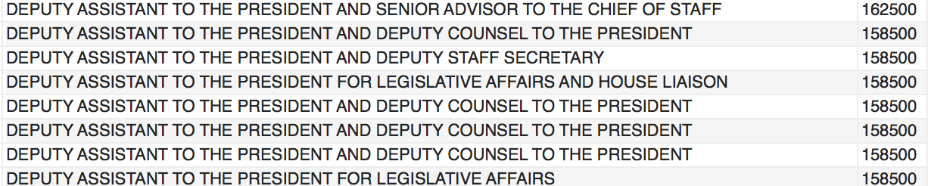
10. Assistant verse Deputy position titles
Code
Salary comparison
In this comparison we see that simply adding “Deputy” to a title is tied to a substantially larger salary
Specifics
We see the highest salary at $162,500 for Deputy whereas without that title we only see $45,000
Output

Slide 13
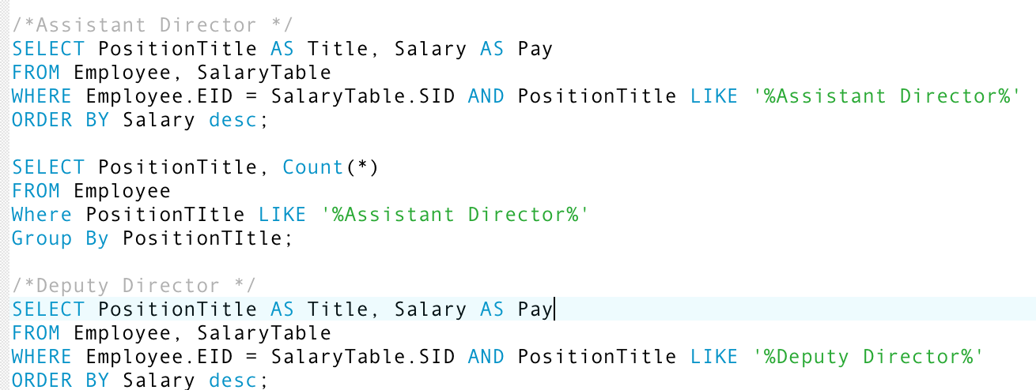
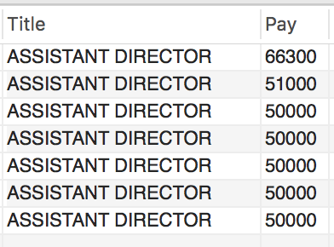
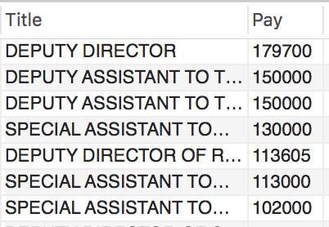
11. Assistant vs. Deputy Director
Code
Salary comparison
Assistants make as low as 27% of what the top Director makes when they are of Deputy status
Specifics
Most of the Assistants make $50,000 while Deputy titles make up to 3X as much
Output

Slide 14
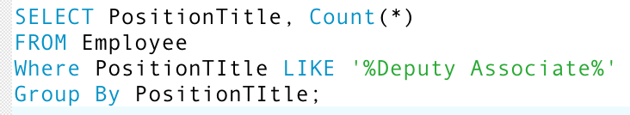
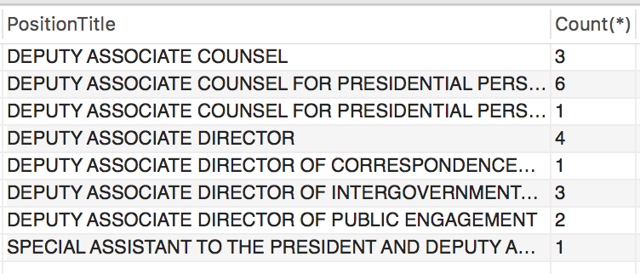
12. A closer look into the count function
Code
Count
When examining “Deputy Associate” position titles, we used the count function to asses variability
Results
This specific position displayed a great amount of variable titles and with a larger count for each respective position title
Output

Slide 15
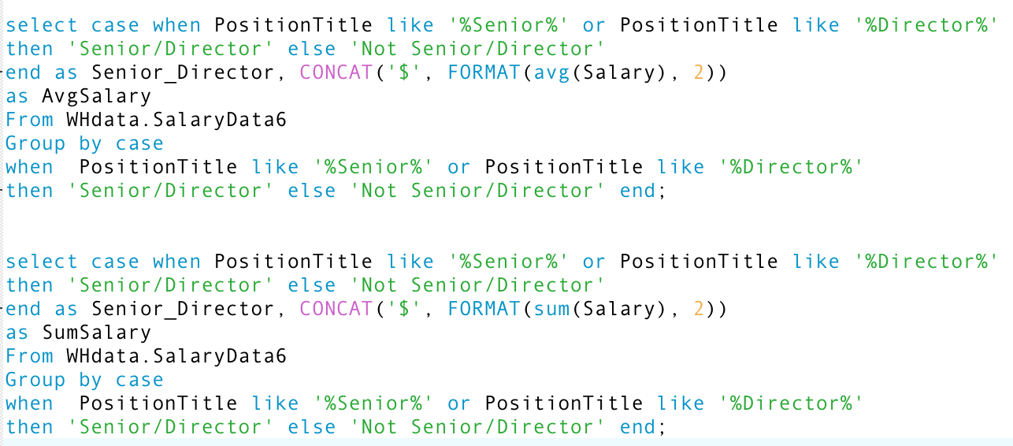
13. Comparing two position titles within one command
Code
Case function
Using the case function to examine Senior and Director position titles
Sum function
Using the case function but with the sum function embedded instead of avg

Slide 16
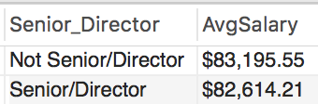
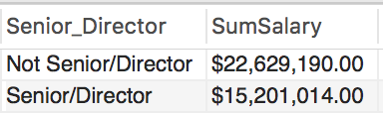
14. Comparing two position titles within one command, results
Output
Results
When looking at the difference of all Senior and Director job titles in the table, the average salaries of non Senior and Director titles were higher than that of normal Senior and Director roles
Analysis
This result is surprising but misleading as we saw a greater count of people who were not Seniors and not Directors, which skewed the data results as indicated by the sum function. Further coding resulted in the expected greater max of Senior and Director titles, meaning that these roles do make the most but not on average

Slide 17


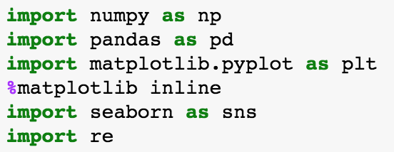
15.Using Python and Jupyter through Mac Terminal
Graphing/visualizing
Used histogram and density plots through python
Analysis
See the greatest frequency of salaries around $45,000

Slide 18
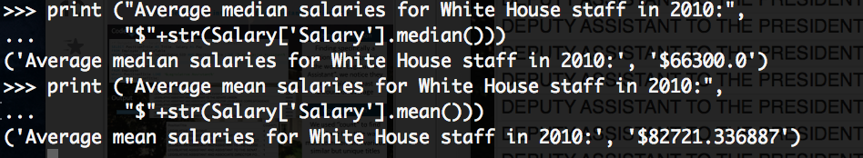
16. Analysis comparison: SQL vs python
Visualization of data
We used numpy, pandas, matplotlib, and seaborn to illustrate our data in terms of salary amount and frequency of that salary
Analysis
MySQL and Python show the same average salaries

Slide 19
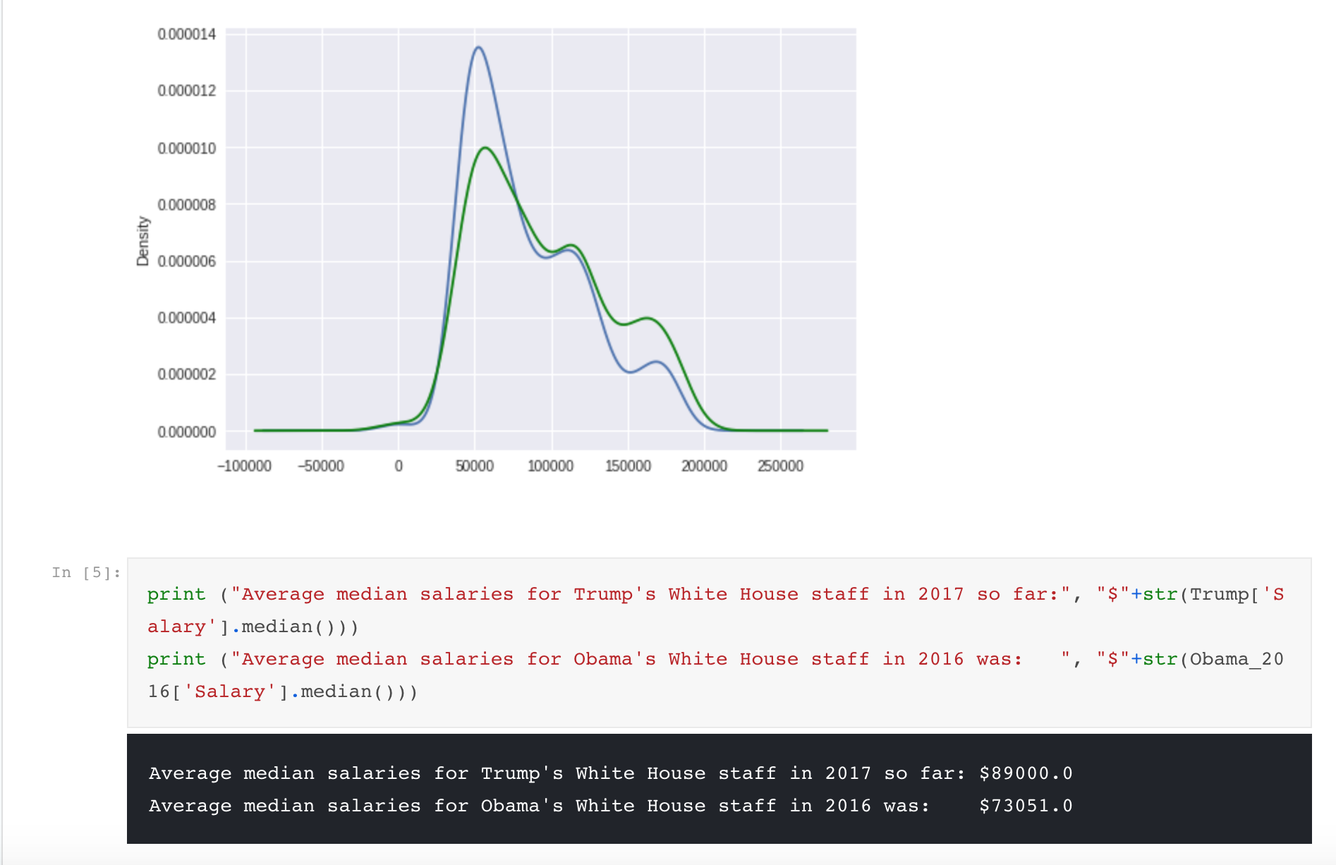
17. Analysis comparison via Kaggle (2 comparisons to ours)
Link to comparison
https://www.kaggle.com/adamschroeder/white-house-salaries-2009-2017 https://www.kaggle.com/cbagchi/comparing-salaries-over-the-years
Analysis
2017 vs 2010 shows a greater median and mean salary as expected and even from 2017 to 2016. The density plot of our analysis versus another Kaggle analysis shows a similar shape and trend

Slide 20
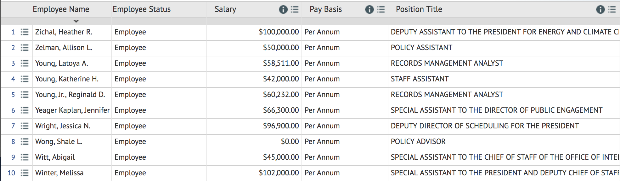
18. Data information
URL: https://opendata.socrata.com/Government/2010-Report-to-Congress-on-White-House-Staff/vedg-c5sb
GitHub Link: https://github.com/AustinLVB/7330SQLclass/tree/master/Final%20Submission
Data Size: 42 KB
Used IBM Bluemix and MySQL Workbench

Slide 21
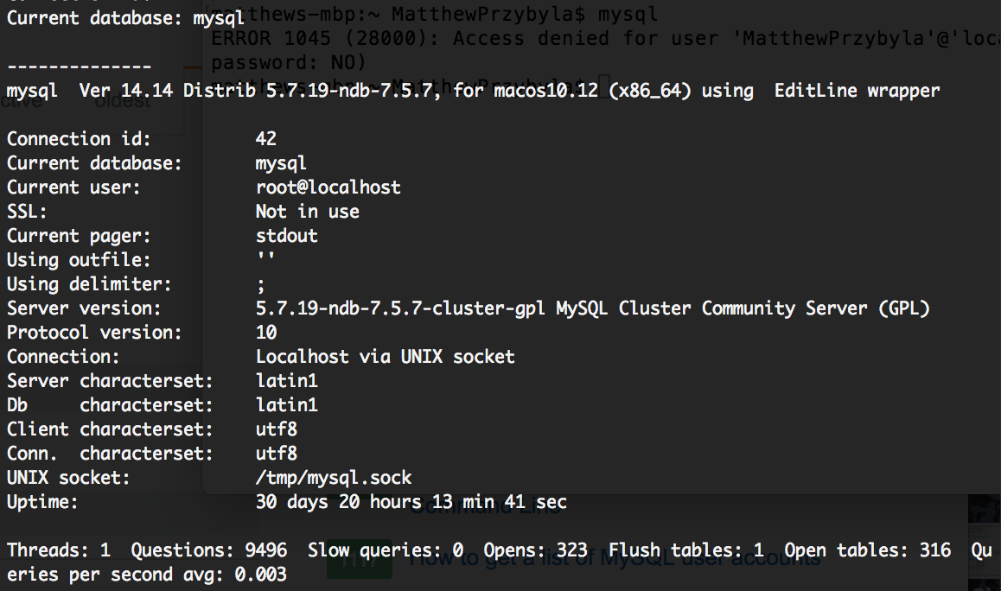
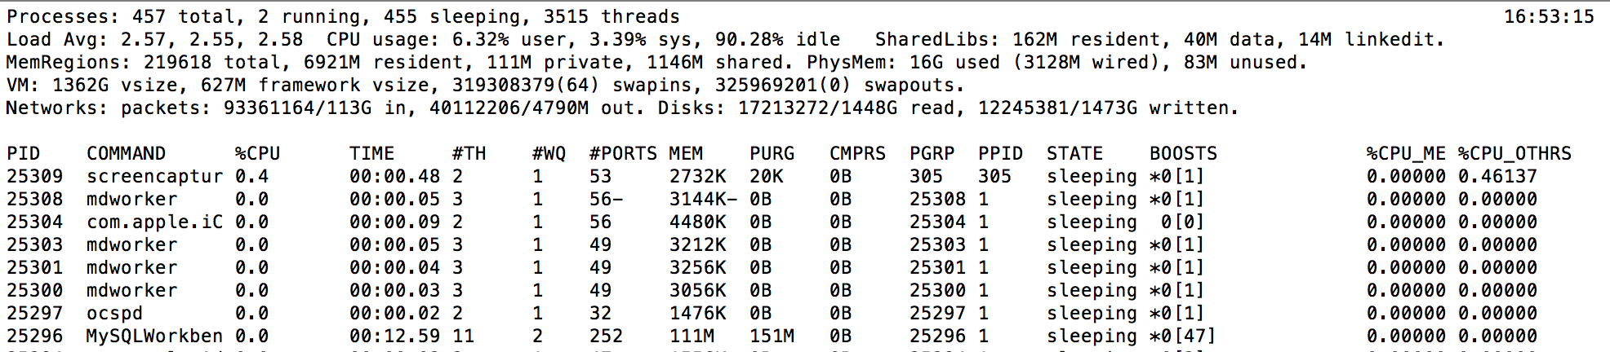
19. MySQL Metrics
Database Server: MySQL Workbench
Used “top” function in command line
CPU Speed: Variant depending on current time
0 of total – not currently querying
Memory Size: 111M

Slide 22
20. SQL code
Please follow this GitHub link for the raw SQL code:
https://github.com/AustinLVB/7330SQLclass/blob/master/WHDB.sql
White House image URL:
https://pixel.nymag.com/imgs/fashion/daily/2017/02/14/14-white-house-at-night.w710.h473.2x.jpg, https://www.thecut.com/2017/02/nighttime-voice-mails-from-the-white-house.html

Slide 23
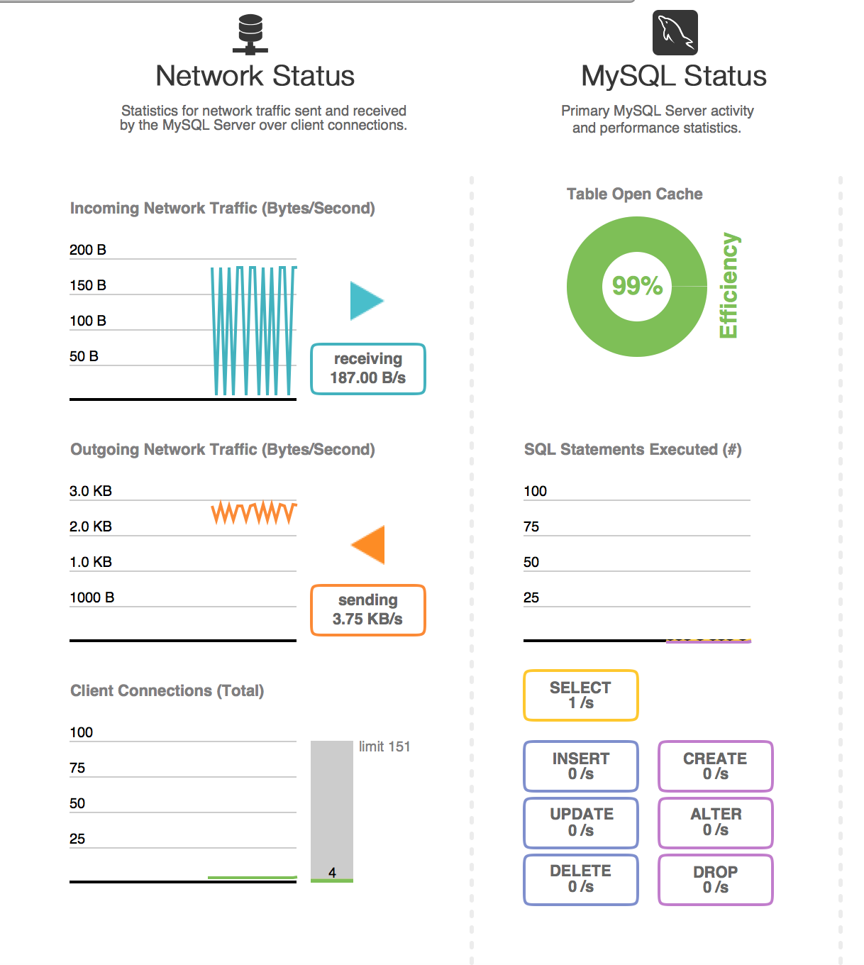
21. Fun question! + Dashboard
How many characters is the longest Position Title?
Bonus: What is the title or what is dealing with?

